Slide 1
Docker? I ‘ardly know ‘er!
An intro to containers

Slide 2
Peter Roberts
Senior Consultant

Slide 3
What is a container?
A container is an abstraction of the application layer
It packages up the application, and dependencies
Containers run on a container runtime
Give an isolated part of the host OS to run things in with its own filesystem, process tree, users, networking
Docker is the most well-known implementation, but others exist
Notes:
-

Slide 4
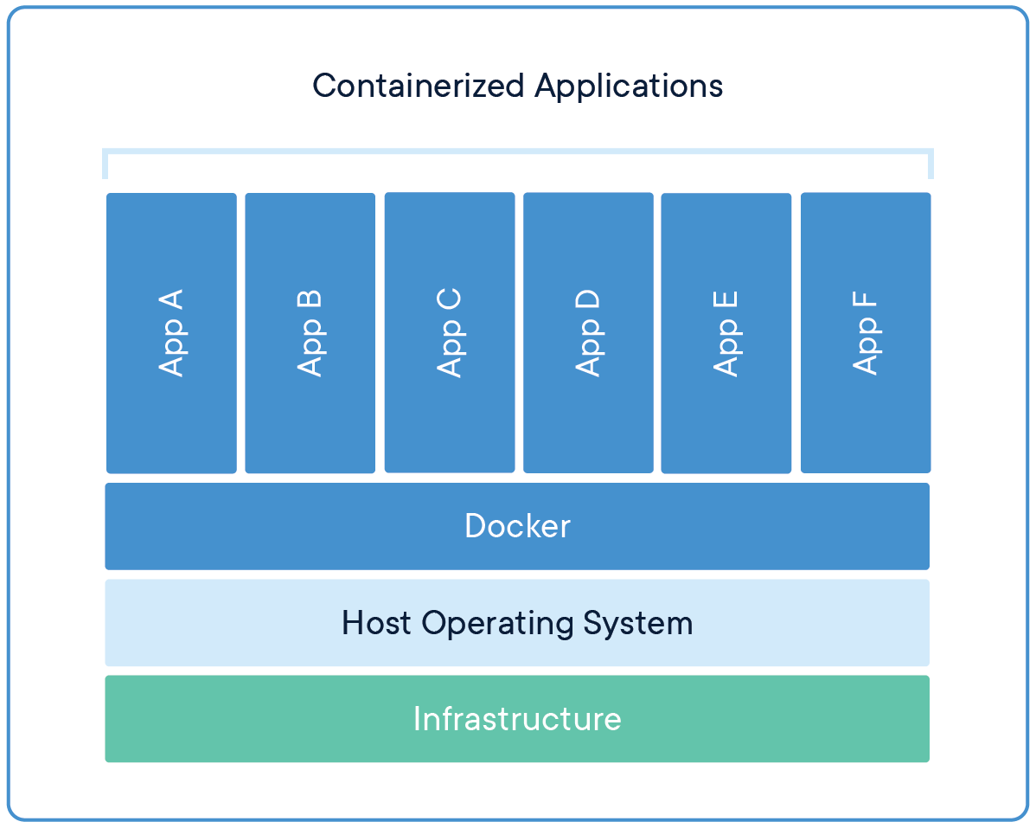
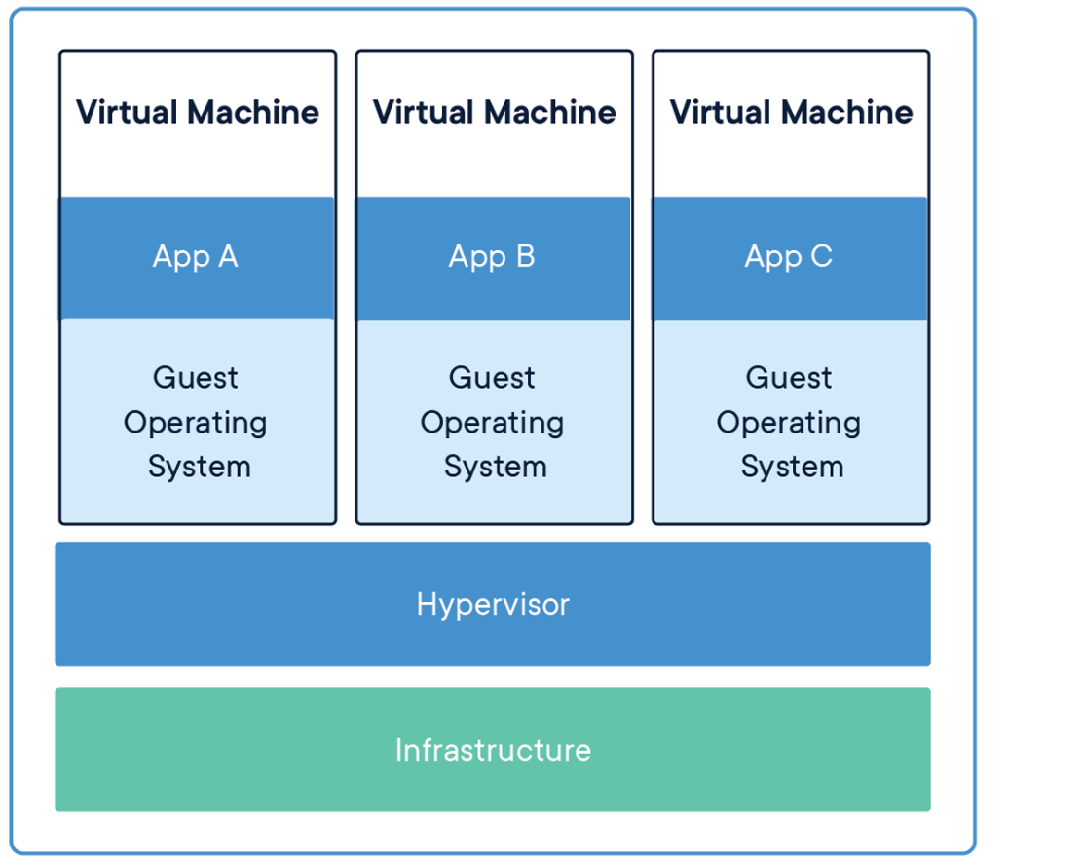
Container vs VM
Containers
VMs
Notes:
VM:
Contains entire OS, runs on top of Hypervisor
Walls off entire OS
Grabs physical resources (CPU, RAM, Network, Storage) and slices off virtual versions for itself
Containers don’t do this
They only slice out file system, process space, users, but essentially all containers share the same underlying OS

Slide 5
What can a container contain?
Can be Windows or Linux
Anything that runs on either of those OS can in theory go into a container
Notes:
Containers can be Windows or Linux
Linux containers use Windows Subsystem for Linux
Is worth noting that there’s also a project floating around to run Mac in Docker, don’t think it’s officially supported and looks like it might be kludging OS X onto Linux
Anything you can stick in a filesystem can go on a container

Slide 6
Containers, huh? What are they good for?
Any program with a dependency on an external runtime/library to run
Lifting and shifting applications to other environments
E.g. picking up a Windows service and running it in Azure
Integration testing
In some cases it makes it feasible to replicate something that looks like the live environment using containers
Local dev environment
Allows you to install whatever weird tools you like without affecting other projects you work on or your main OS
Microservices applications (with container orchestrators)
Notes:
The age-old problem: your application runs fine on your PC, but not on the customer’s PC. What if you could just pick up and ship your PC?
Well, by packaging up your app along with all its dependencies you can essentially do that
A Docker container will run anywhere a compliant container runtime is installed so it’s ideal for lifting and shifting an application
You will likely have some need to
NodeJS is a good example – as it doesn’t like having multiple versions of the runtime installed on the OS, containers get round that
I’ve mentioned container orchestrators here
These manage multiple containers and service discovery between them
Kubernetes is an example of one
I won’t go into much detail here as it’s its own talk

Slide 7
Building a container
Containers are built from Dockerfiles
These define:
- The base image for your container
- Could be bare OS or an image with some more stuff in it
- Steps to apply on top of that base image to generate the image you want
Running docker build against a Dockerfile will create an image, which is saved to your local PC by default

Slide 8
When do you not need containers?
Docker isn’t the solution a lot of the time
There are very often easier ways to accomplish your goals than using containers
E.g. a lot of PaaS solutions which work on a higher level of abstraction
Using Docker in dev doesn’t lock you into using it in production
Notes:
You don’t always need Docker
It comes with its own challenges so you need to weigh up whether those are worth it
In many cases (e.g. Azure PaaS services such as web apps) there are better places to run your application
Customers in the past have asked us if Docker is right fit for their app, the answer has been no
Example: App service websites, Functions
Just because Docker is used in dev doesn’t mean need to run container in prod
Example: website with DB might be containers locally, but could be Azure App Service/SQL in cloud

Slide 9
Container Registries

